Slide 1
Computer Graphics Rendering
Lecture 17: Fast rendering pipelines (shaders)
Kartic Subr

Slide 2

… 1992
Vertex Data
Vertex Transform and Lighting
Primitive
Setup and Rasterization
Fragment Coloring and Texturing
Blending
Pixel Data
Texture Store
Application Programming Interface (API) for
functionality that was implemented in hardware

Slide 3
… 2010
4.1
(latest is 4.6)
Vertex Data
Vertex Shader
Primitive
Setup and Rasterization
Fragment Shader
Blending
Tessellation Control Shader
Tessellation Evaluation Shader
Geometry Shader
Pixel Data
Texture Store

Slide 4
Developing applications
Game/application main control logic
Vertex Shader
Geometry Shader
Fragment Shader

Slide 5
graphics pipeline
output image
(render target)

Slide 6
input
assembler
vertex
shader
hull
shader
domain
shader
geometry
shader
pixel
shader
output
merger
tessellator
rasteriser
output image
(render target)
fixed functions – change parameters
shaders – fully programmable

Slide 7
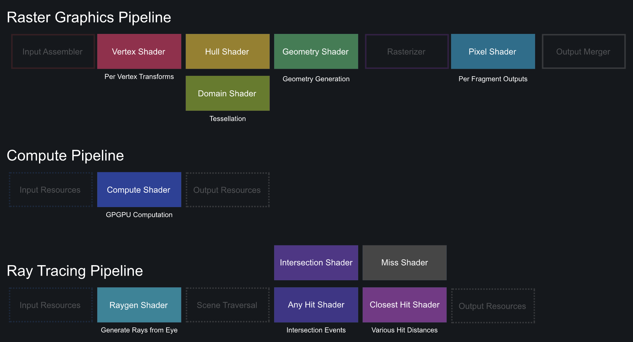
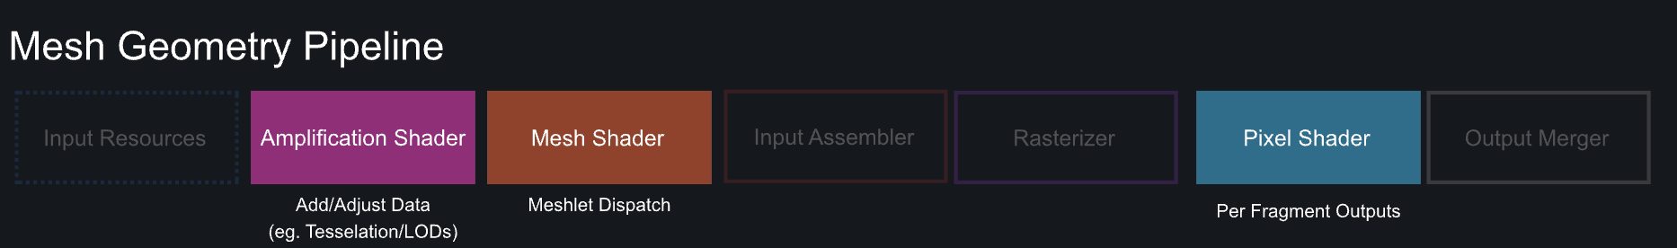
https://alain.xyz/blog/a-review-of-shader-languages

Slide 8
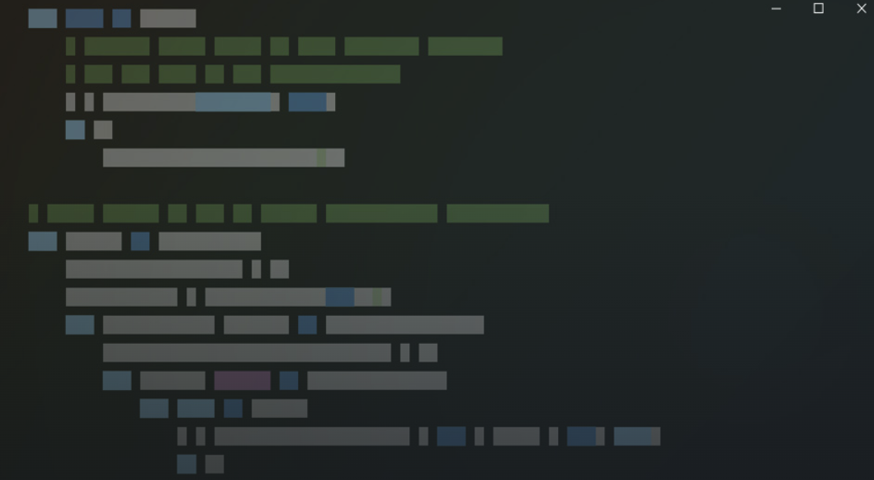
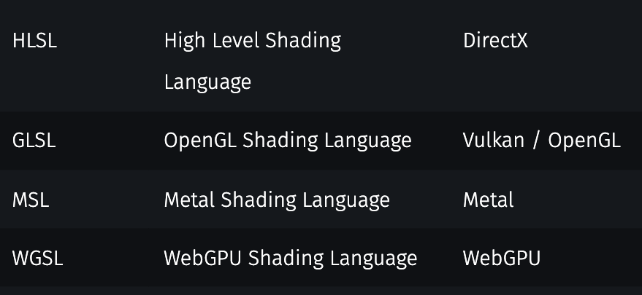
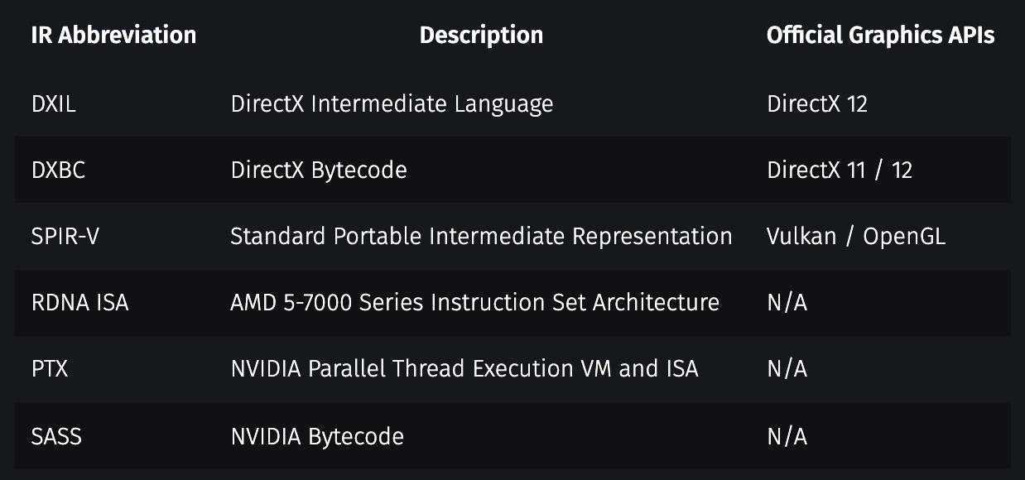
compiler
shader
Intermediary representation
GPU-specific code

Slide 9
driver
shader
Intermediary representation
GPU-specific code

Slide 10
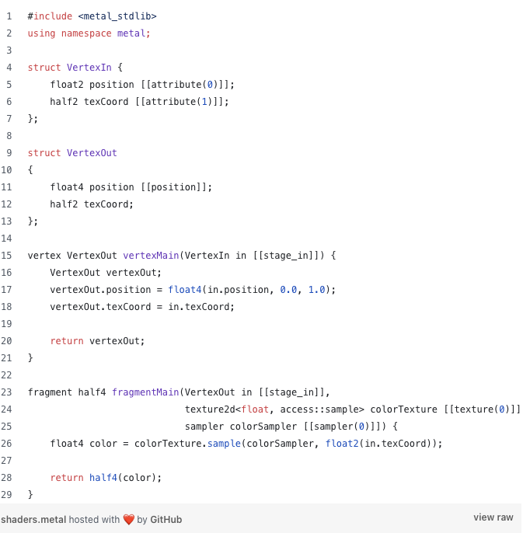
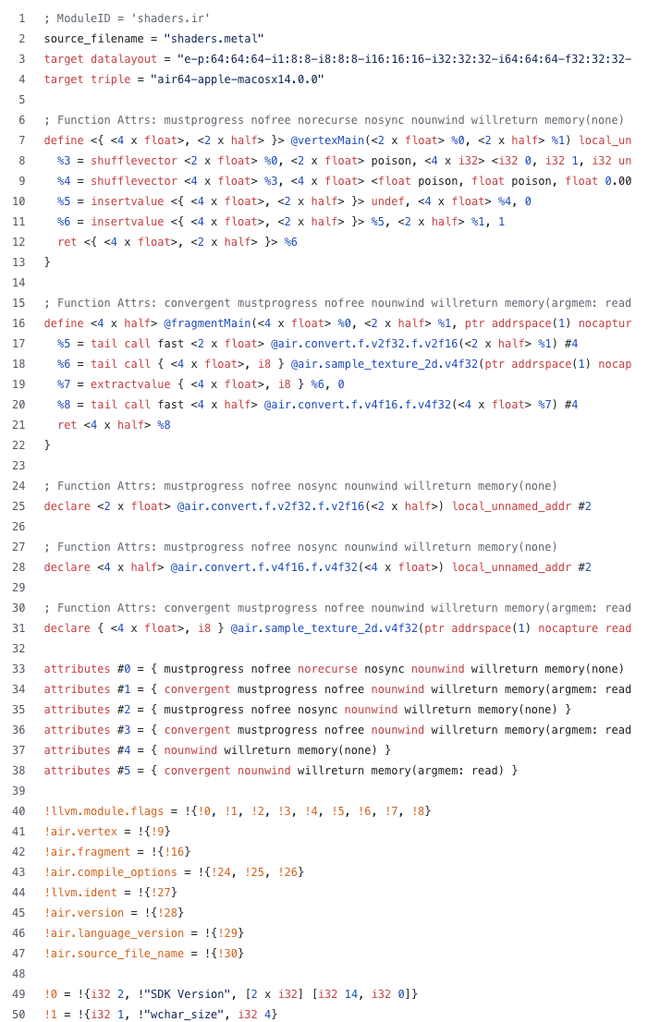
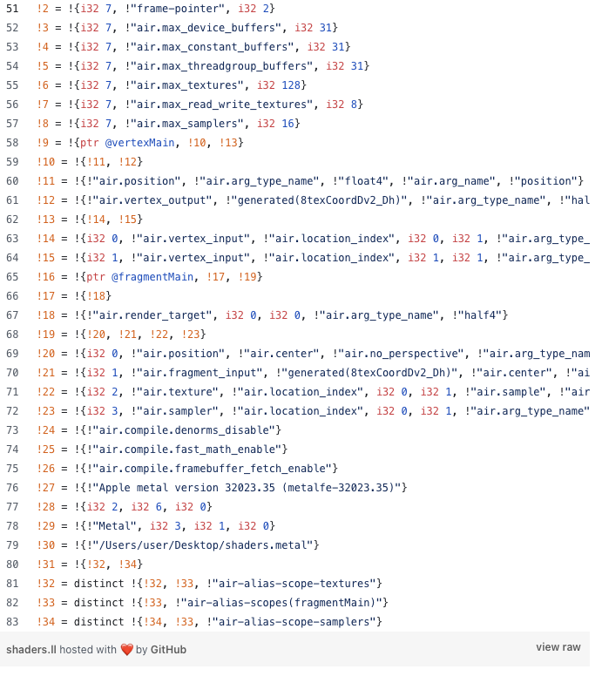

Slide 12
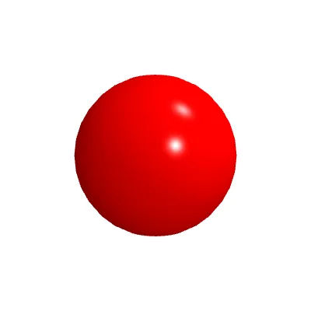

Vertex shader example
https://p5js.org/tutorials/intro-to-shaders/

Slide 13

Vertex shader code can use ‘time’ variable

Slide 14
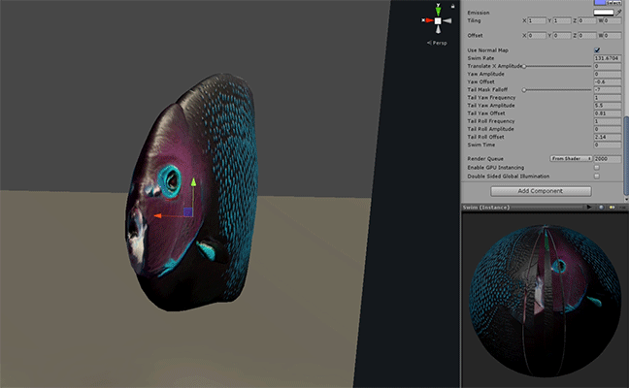
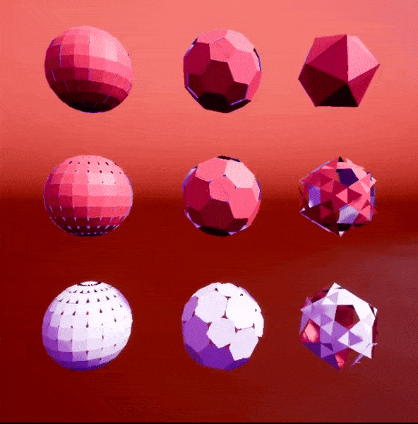
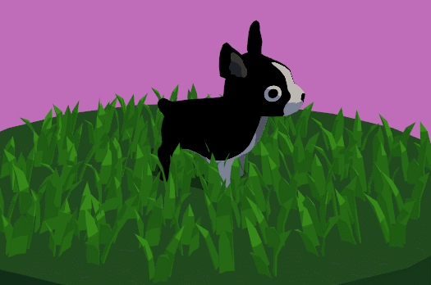

Slide 15
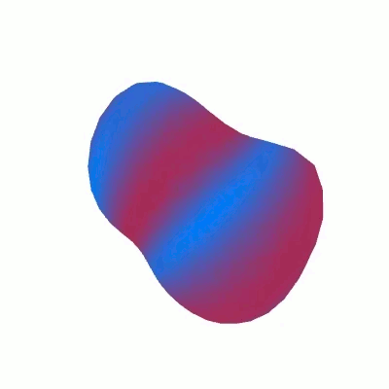
Fragment shader example

Slide 16
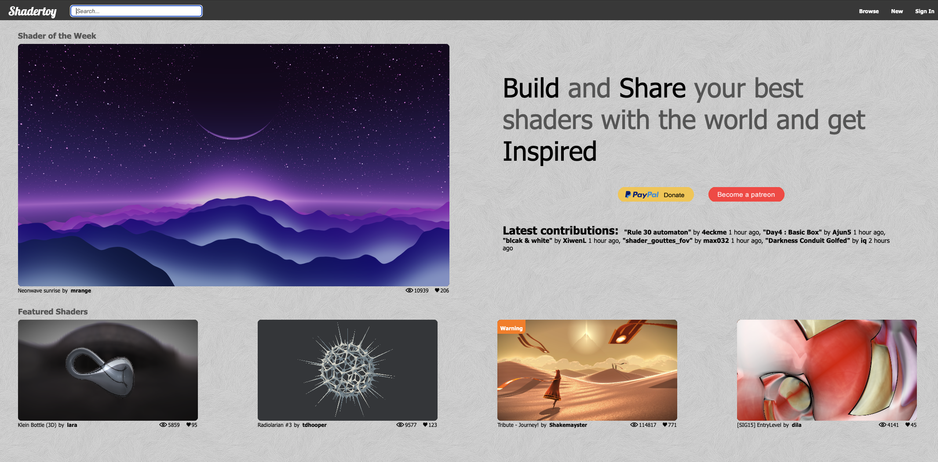
GLSL on ShaderToy
https://www.shadertoy.com

Slide 17
Live demos …

